Slide 1

Database Systems(Lab)
Week 01 – (DB Introduction)

Slide 2
Syeda Ravia Ejaz
Instructor Software Engineering
FAST School of Computing
National University of Computer & Emerging Sciences-Karachi Campus

Slide 3

About Me
Bachelor’s Of Computer Science
Specialization in Computer Science
Batch-2k20

Slide 4
About Me
Email | ravia.ijaz@nu.edu.pk
Office Hours | Monday : 10am – 1pm Friday : 10am – 1pm
Office | CS Basement 2 Room # 4
Google Classroom Code | Google invite

Slide 5
Course Marks Details
Database Systems Lab
Assessment Item | Number | Weight (%)
Class activity | 10 | 10
Lab Tasks | 10 | 10
Midterm Exam | 1 | 25
Project | 1 | 5
Final Exam | 1 | 50
Total | 23 | 100

Slide 6
Course/Class Policies
Retake of Lab Task/Activity will subject to the penalty of 20% deduction in marks.
Attend the Class only if you are interested to Learn.
Maintain overall decorum of the classroom.
Be Punctual, Prepared, Polite and Productive.
Pop Up Quiz will be held after every 2 weeks. (Surprised quiz)
Avoid Plagiarism, this would lead to 100% of marks deduction. (Only 5-8% Allowed)
Late Assignments Submission will be subject to the penalty which is as follows:
      After 2 Day of Deadline 20% of marks deductions
      After 3 Days of Deadline 30% of marks deductions
      After 4 Days of Deadline no marks will be awarded

Slide 7
Course Objectives
Basic database concepts
Conceptual modelling
Relational data model
Relational theory and languages
Database design, SQL
Introduction to query processing and optimization,
Introduction to concurrency and recovery with advance topics.

Slide 8
Textbook and Reference Material
Textbook (or Laboratory Manual for Laboratory Courses) | Ramez Elmasri & Shamkant B. Navathe, Database Systems, Models, Languages, Design and Application Programming, 7th Edition, 2016.
Reference Material | 1) Thomas Connolly, Carolyn Begg, Database Systems: A practical approach to design, implementation and Management, 6th Edition, 2015. 2) C.J. Date, An Introduction to Database Systems, 8th Edition, 2004

Slide 9
Let’s Explore !!!

Slide 10
Lab-01 Objectives
Database
SQL
Basic SQL Concepts

Slide 11
Data vs Information
Data:
Data refers to raw facts, figures, or observations without any context or interpretation.
It represents individual pieces of information that are not yet processed or organized in a meaningful way.
Data can include numbers, text, images, or any type of information that can be stored and retrieved from a database.
Data can be considered the building blocks from which information is derived.
Information:
Information is data that has been processed, organized, and given context to make it meaningful and useful.
Information provides insights, understanding, and knowledge by presenting data in a structured and coherent manner.
Information is the result of data that has been analyzed, interpreted, and presented in a format that is relevant and understandable to users.
Information answers specific questions or addresses certain needs, helping users make informed decisions.

Slide 12
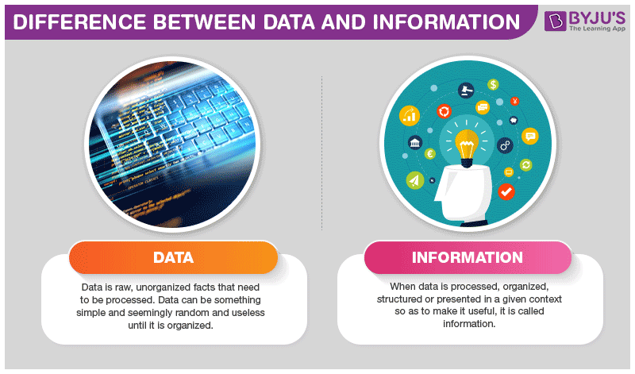
Data vs Information (Example)
Data:
The individual entries in the table, such as names, addresses, phone numbers, and purchase amounts, are the raw data
Information:
Analyzing the data to find the total sales for each customer, identifying the top-spending customers, and presenting this data in a report or visualization is the information derived from the data.

Slide 13
Database
A database is a systematic collection of data. They support electronic storage and manipulation of data. Databases make data management easy.
Example #1
An online telephone directory uses a database to store data of people, phone numbers, and other contact details. Your electricity service provider uses a database to manage billing, client-related issues, handle fault data, etc.
Example #2
Facebook needs to store, manipulate, and present data related to members, their friends, member activities, messages, advertisements, and a lot more. We can provide a countless number of examples for the usage of databases.

Slide 14
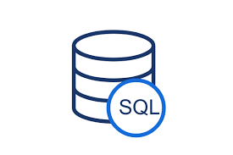
SQL
SQL is the standard language for dealing with Relational Databases. SQL can be used to insert, search, update, and delete database records. SQL can do lots of other operations, including optimizing and maintenance of databases. SQL stands for Structured Query language, pronounced as "S-Q-L" or sometimes as "See-Quel"... Relational databases like MySQL Database, Oracle, MS SQL Server, Sybase, etc. use ANSI SQL.

Slide 15
Basic SQL Concepts
Datatypes: In the context of databases and SQL (Structured Query Language), a datatype is a classification that specifies which type of data a particular column can hold in a relational database table. Each column in a database table must have a defined datatype, which determines the kind of values that can be stored in that column. Datatypes ensure data integrity, optimize storage, and provide a framework for performing various operations on the stored data.
bigint | decimal | real | char | nvarchar
int | numeric | datetime | varchar | nvarchar(max)
smallint | money | smalldatetime | varchar(max) | ntext
tinyint | smallmoney | date | text | binary
bit | float | time | nchar | varbinary
varbinary(max) | image

Slide 16
Basic SQL Concepts
Arithmetic operators:
Addition | Subtraction | Multiplication | Division | Modulus
+ | - | * | / | %

Slide 17
Basic SQL Concepts
SQL Comparison Operators:
= | Checks if the values of two operands are equal or not, if yes then condition becomes true.
!= | Checks if the values of two operands are equal or not, if values are not equal then condition becomes true.
<> | Checks if the values of two operands are equal or not, if values are not equal then condition becomes true.
> | Checks if the value of left operand is greater than the value of right operand, if yes then condition becomes true.
< | Checks if the value of left operand is less than the value of right operand, if yes then condition becomes true.
>= | Checks if the value of left operand is greater than or equal to the value of right operand, if yes then condition becomes true.
<= | Checks if the value of left operand is less than or equal to the value of right operand, if yes then condition becomes true.
!< | Checks if the value of left operand is not less than the value of right operand, if yes then condition becomes true.
!> | Checks if the value of left operand is not greater than the value of right operand, if yes then condition becomes true.

Slide 18
Basic SQL Concepts
SQL Logical Operators
ALL | The ALL operator is used to compare a value to all values in another value set.
AND | The AND operator allows the existence of multiple conditions in an SQL statement's WHERE clause
ANY | The ANY operator is used to compare a value to any applicable value in the list as per the condition.
BETWEEN | The BETWEEN operator is used to search for values that are within a set of values, given the minimum value and the maximum value.
EXISTS | The EXISTS operator is used to search for the presence of a row in a specified table that meets a certain criterion.
IN | The IN operator is used to compare a value to a list of literal values that have been specified.
LIKE | The LIKE operator is used to compare a value to similar values using wildcard operators.
NOT | The NOT operator reverses the meaning of the logical operator with which it is used. Eg: NOT EXISTS, NOT BETWEEN, NOT IN, etc. This is a negate operator.
OR | The OR operator is used to combine multiple conditions in an SQL statement's WHERE clause.
NULL | The NULL operator is used to compare a value with a NULL value.
UNIQUE | The UNIQUE operator searches every row of a specified table for uniqueness (no duplicates).

Slide 19
Basic SQL Concepts
SQL Logical Operators
ALL | The ALL operator is used to compare a value to all values in another value set.
AND | The AND operator allows the existence of multiple conditions in an SQL statement's WHERE clause
ANY | The ANY operator is used to compare a value to any applicable value in the list as per the condition.
BETWEEN | The BETWEEN operator is used to search for values that are within a set of values, given the minimum value and the maximum value.
EXISTS | The EXISTS operator is used to search for the presence of a row in a specified table that meets a certain criterion.
IN | The IN operator is used to compare a value to a list of literal values that have been specified.
LIKE | The LIKE operator is used to compare a value to similar values using wildcard operators.
NOT | The NOT operator reverses the meaning of the logical operator with which it is used. Eg: NOT EXISTS, NOT BETWEEN, NOT IN, etc. This is a negate operator.
OR | The OR operator is used to combine multiple conditions in an SQL statement's WHERE clause.
NULL | The NULL operator is used to compare a value with a NULL value.
UNIQUE | The UNIQUE operator searches every row of a specified table for uniqueness (no duplicates).

Slide 20


Slide 21
Its Time to Run Queries Now…
Open sqldeveloper Application and Start Practicing

